Slide 1
Machine Learning Supervised Learning Bayesian Classifier for continues feature(s)
Instructor: Zainab Yousuf

Slide 2
Content
Bayesian Classifier
Classification using Bayesian classifier over Continuous Data

Slide 3
Bayesian Classifier
Taking the same example of the previous lecture of customers whether they will buy a computer or not
If the Income features is changed from discrete values {low, medium, high} to continuous values{any range of the income}
How the probabilities will be calculated???

Slide 4
Previously the dataset was like this in which the income feature has a discrete set of values. If we change this to range (in next slide)
S.No | Age | Income | Student | Credit rating | Class: Buy Computer
1 | <30 | High | No | Fair | No
2 | <30 | High | No | Excellent | No
3 | 30-40 | High | No | Fair | Yes
4 | >40 | Medium | No | Fair | Yes
5 | >40 | Low | Yes | Fair | Yes
6 | >40 | Low | Yes | Excellent | No
7 | 30-40 | Low | Yes | Excellent | Yes
8 | <30 | Medium | No | Fair | No
9 | <30 | Low | Yes | Fair | Yes
10 | >40 | Medium | Yes | Fair | Yes
11 | <30 | Medium | Yes | Excellent | Yes
12 | 30-40 | Medium | No | Excellent | Yes
13 | 30-40 | High | Yes | Fair | Yes
14 | >40 | Medium | No | Excellent | No

Slide 5
Now the income features in dataset is a range and we cant calculate the probability of a range like we did previously for the discrete values.
S.No | Age | Income ($) | Student | Credit rating | Class: Buy Computer
1 | <30 | 500 | No | Fair | No
2 | <30 | 650 | No | Excellent | No
3 | 30-40 | 525 | No | Fair | Yes
4 | >40 | 320 | No | Fair | Yes
5 | >40 | 210 | Yes | Fair | Yes
6 | >40 | 200 | Yes | Excellent | No
7 | 30-40 | 230 | Yes | Excellent | Yes
8 | <30 | 300 | No | Fair | No
9 | <30 | 215 | Yes | Fair | Yes
10 | >40 | 325 | Yes | Fair | Yes
11 | <30 | 315 | Yes | Excellent | Yes
12 | 30-40 | 305 | No | Excellent | Yes
13 | 30-40 | 565 | Yes | Fair | Yes
14 | >40 | 335 | No | Excellent | No

Slide 6
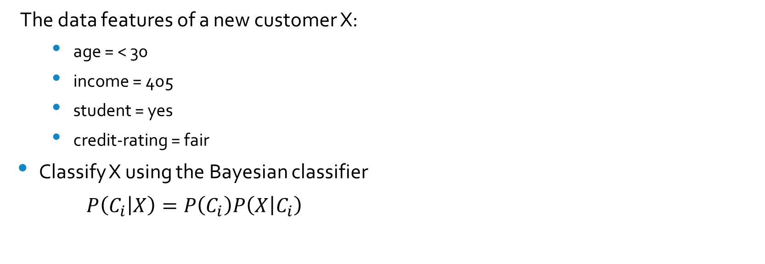
Example (Cont..)
The data features of a new customer X:
age = < 30
income = 405
student = yes
credit-rating = fair
Classify X using the Bayesian classifier
$P\left(C_{i} | X\right)=P\left(C_{i}\right)P\left(X | C_{i}\right)$

Slide 7
First Few steps will be same

Slide 8
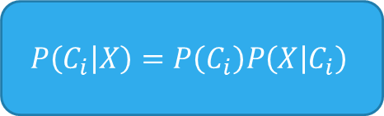
Example (Cont..)
$$P\left(C_{i} | X\right)=P\left(C_{i}\right)P\left(X | C_{i}\right)$$
There are two classes (C1 & C2) so, we need to find the prior probability P(Ci) for both.
P(C1) = P(Buy Computer = yes)
= samples with class C1/ total samples
= 9/14 = 0.643
P(C2) =P(Buy Computer = no)
= samples with class C2/ total samples
= 5/14 = 0.357

Slide 9

Example (Cont..)
$$P\left(C_{i} | X\right)=P\left(C_{i}\right)P\left(X | C_{i}\right)$$
To compute P(X|Ci), we need to compute the following conditional probabilities for each attribute first,
P(age=“<30” | Buy Computer = Yes)
P(income=“405” | Buy Computer = Yes)
P(Student=“Yes” | Buy Computer = Yes)
P(Credit rating=“Fair” | Buy Computer = Yes)
P(X|Buy Computer=Yes) =?
P(age=“<30” | Buy Computer = No)
P(income=“405” | Buy Computer = No)
P(Student=“Yes” | Buy Computer = No)
P(Credit rating=“Fair” | Buy Computer = No)
P(X|Buy Computer=No) =?
P(X|C1)
P(X|C2)

Slide 10

To compute P(x1|Ci):
P(age=“<30” | Buy Computer = Yes)
$\text{P}\text{(}\text{X}\text{|}\text{Y}\text{)}=\frac{\text{P}\text{(}\text{X} \text{∩} \text{Y}\text{)}}{\text{P}\text{(}\text{X}\text{)}}$
$\frac{\text{P}\text{(}\text{age}\text{=“<30” }\text{and} \text{Buy} \text{Computer}\text{=}\text{Yes}\text{)}}{\text{P}\text{(}\text{age}\text{=“<30”) }}$
$=\frac{(2/9)}{(5/14)}$
P(age=“<30” | Buy Computer = No)
$\text{P}\text{(}\text{X}\text{|}\text{Y}\text{)}=\frac{\text{P}\text{(}\text{X} \text{∩} \text{Y}\text{)}}{\text{P}\text{(}\text{X}\text{)}}$
$\frac{\text{P}\text{(}\text{age}\text{=“<30” }\text{and} \text{Buy} \text{Computer}\text{=}\text{No}\text{)}}{\text{P}\text{(}\text{age}\text{=“<30”) }}$
$=\frac{(3/5)}{(5/14)}$

Slide 11

Example (Cont..)
$$P\left(C_{i} | X\right)=P\left(C_{i}\right)P\left(X | C_{i}\right)$$
To compute P(X|Ci), we need to compute the following conditional probabilities for each attribute first,
P(age=“<30” | Buy Computer = Yes) =2/9=0.222
P(Student=“Yes” | Buy Computer = Yes) =6/9=0.667
P(Credit rating=“Fair” | Buy Computer = Yes) =6/9=0.667
P(income=“405” | Buy Computer = Yes) =???
P(X|Buy Computer=Yes) = 0.222 * 0.667 *0.667*?= ?
P(age=“<30” | Buy Computer = No) =3/5=0.600
P(Student=“Yes” | Buy Computer = No) =1/5=0.200
P(Credit rating=“Fair” | Buy Computer = No) =2/5= 0.400
P(income=“405” | Buy Computer = No) =???
P(X|Buy Computer=No) = 0.600 * 0.200 * 0.400*?= ?
P(X|C1)
P(X|C2)

Slide 12
P(income=“405” | Buy Computer = Yes)
For class “Yes”- Separate the values of income that belongs to “Yes” class as follows:
Income | Class: Buy Computer
525 | Yes
320 | Yes
210 | Yes
230 | Yes
215 | Yes
325 | Yes
315 | Yes
305 | Yes
565 | Yes

Slide 13
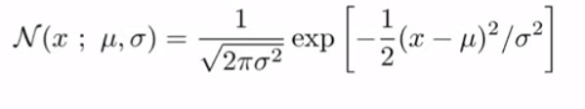
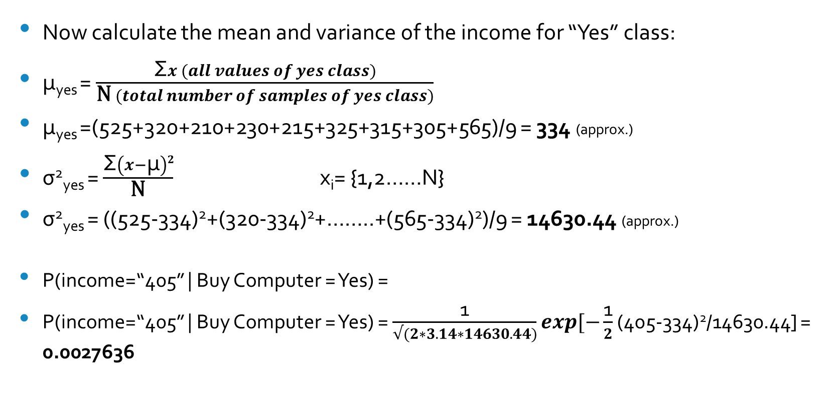
P(income=“405” | Buy Computer = Yes)
Now calculate the mean and variance of the income for “Yes” class:
μ_{yes} = $\frac{\text{Σ}x (all values of yes class)}{\text{N} (total number of samples of yes class)}$
μ_{yes} =(525+320+210+230+215+325+315+305+565)/9 = 334 (approx.)
σ²_{yes} = $\frac{\text{Σ}\left(x−\text{μ}\right)2}{\text{N}}$ x_{i}= {1,2……N}
σ²_{yes} = ((525-334)²+(320-334)²+……..+(565-334)²)/9 = 14630.44 (approx.)
P(income=“405” | Buy Computer = Yes) =
P(income=“405” | Buy Computer = Yes) = $\frac{\text{1}}{√(2∗3.14∗14630.44)}exp[−\frac{\text{1}}{2}$(405-334)²/14630.44] = 0.0027636

Slide 14
P(income=“405” | Buy Computer = No)
For class “NO”- Separate the values of income that belongs to “No” class as follows:
Income | Class: Buy Computer
500 | No
650 | No
200 | No
300 | No
335 | No

Slide 15
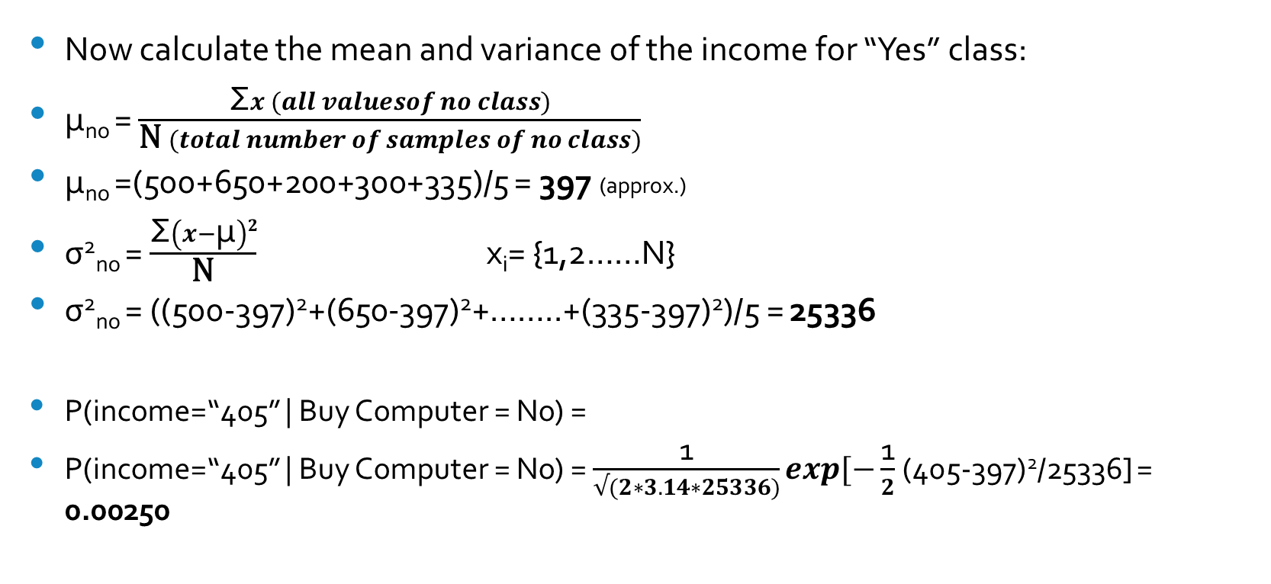
P(income=“405” | Buy Computer = NO)
Now calculate the mean and variance of the income for “Yes” class:
μ_{no} = $\frac{\text{Σ}x (all valuesof no class)}{\text{N} (total number of samples of no class)}$
μ_{no} =(500+650+200+300+335)/5 = 397 (approx.)
σ²_{no} = $\frac{\text{Σ}\left(x−\text{μ}\right)2}{\text{N}}$ x_{i}= {1,2……N}
σ²_{no} = ((500-397)²+(650-397)²+……..+(335-397)²)/5 = 25336
P(income=“405” | Buy Computer = No) =
P(income=“405” | Buy Computer = No) = $\frac{\text{1}}{√(2∗3.14∗25336)}exp[−\frac{\text{1}}{2}$(405-397)²/25336] = 0.00250

Slide 16
Example (Cont..)
$$P\left(C_{i} | X\right)=P\left(C_{i}\right)P\left(X | C_{i}\right)$$
To compute P(X|Ci), we need to compute the following conditional probabilities for each attribute first,
P(age=“<30” | Buy Computer = Yes) =2/9=0.222
P(Student=“Yes” | Buy Computer = Yes) =6/9=0.667
P(Credit rating=“Fair” | Buy Computer = Yes) =6/9=0.667
P(income=“405” | Buy Computer = Yes) =0.027636
P(X|Buy Computer=Yes) = 0.222 * 0.667 *0.667*0.027636= 0.002729
P(age=“<30” | Buy Computer = No) =3/5=0.600
P(Student=“Yes” | Buy Computer = No) =1/5=0.200
P(Credit rating=“Fair” | Buy Computer = No) =2/5= 0.400
P(income=“405” | Buy Computer = No) =0.0250
P(X|Buy Computer=No) = 0.600 * 0.200 * 0.400*0.0250= 0.00120
P(X|C1)
P(X|C2)

Slide 17
Example (Cont..)
$$P\left(C_{i} | X\right)=P\left(C_{i}\right)P\left(X | C_{i}\right)$$
According to previous calculations (slide 14&17)
P(C1) = P(Buy Computer=Yes) = 0.643
P(X| C1) = P(X|Buy Computer=Yes) = 0.002729
P(C2) = P(Buy Computer=No) = 0.357
P(X| C2) = P(X|Buy Computer=No) = 0.00120
Now posterior probability P(Ci|X) = P(X|Ci) P(Ci) for each class can be computed as
P(Buy Computer=Yes|X) = P(X|Buy Computer=Yes) P(Buy Computer=Yes)
P(C1|X) = P(X|C1)P(C1)
= 0.002729 * 0.643= 0.00175
P(Buy Computer=No|X) = P(X|Buy Computer=No) P(Buy Computer=No)
P(C2|X) = P(X|C2)P(C2)
= 0.00120 * 0.357= 0.00042
Hence the Bayesian classifier predicts that the student will buy computer.

Slide 18
Conclusion
Since P(C1|X) > P(C2|X)
The new customer X will buy computer.
If the dataset contains more then one feature having continuous values:
Calculate mean and variance of each feature for each class
Calculate probabilities of each class for all the continuous features using the formula

Slide 19
Thank You

